Slide 1
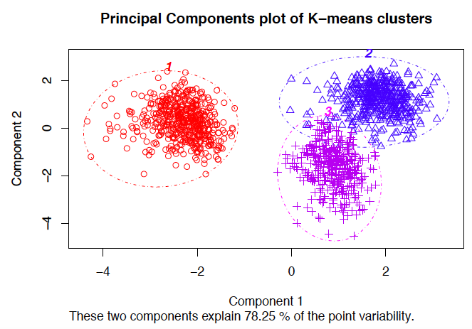
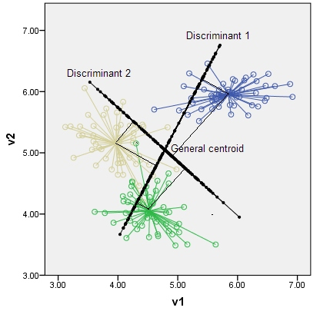
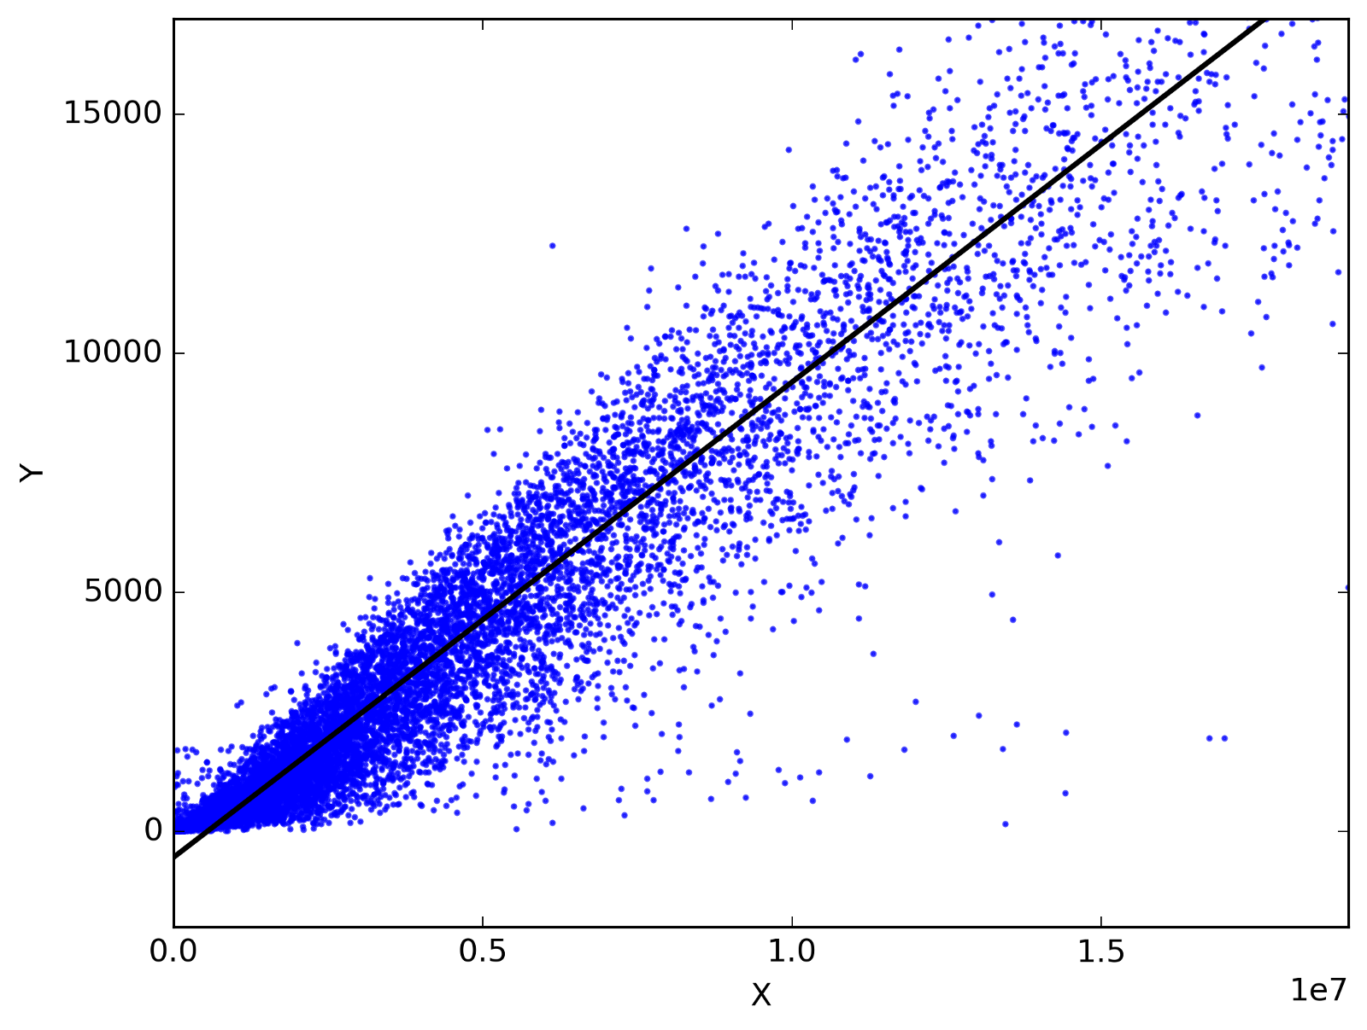
QML Alpha
Quantitative Machine Learning
Alpha Design Platform
Sorin Alexe, November 2025
salexe@qmlalpha.com

Slide 2
Outline
QML Alpha
  Machine Learning Alpha Discovery with Human in-the-loop
  GUI for Flexible Research Interaction
  Library of Model-averaging Methods
  Library of Machine Learning Algorithms
Tools for Large-scale Simulations
Framework for Denoising Data
Feature Extraction
Customized Risk Models
Customized Groupings
Seamless Transfer of Models from Research to Production
Tools for Alpha Management

Slide 3
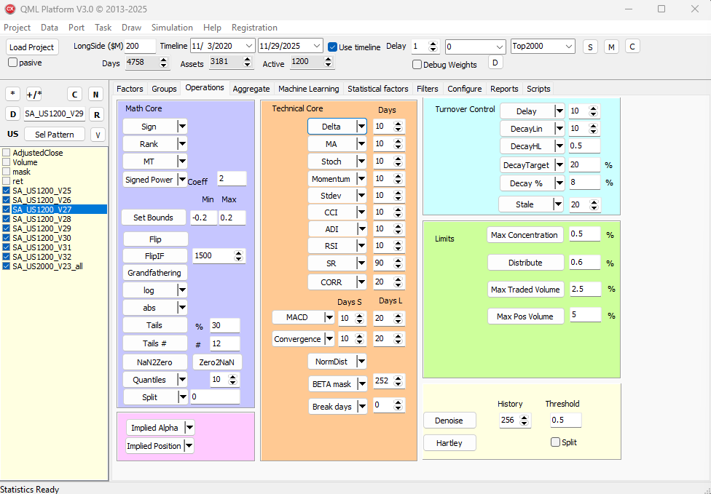
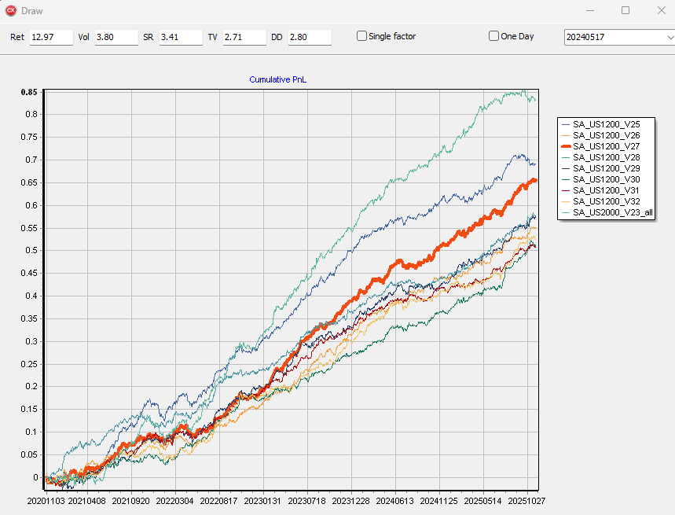
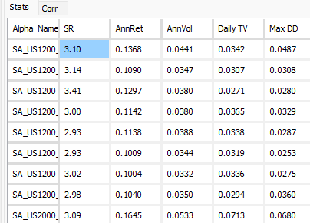
QML Alpha
Machine Learning alpha discovery
with human in-the-loop
Direct interaction via design desktop
No programming skills required
Fast PnL plots and performance reports
Mathematical transformations and Technical Indicators
  Ranks, Moving Averages, Stochastic Indicator, MACD …
Hedging
  Factor neutralization
  Group neutralization
  Turnover and concentration constraints

Slide 4
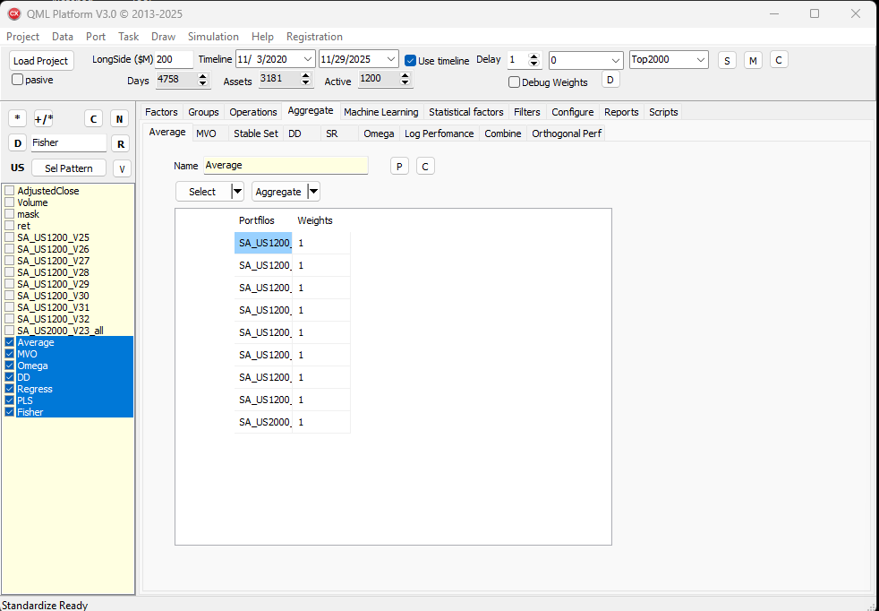
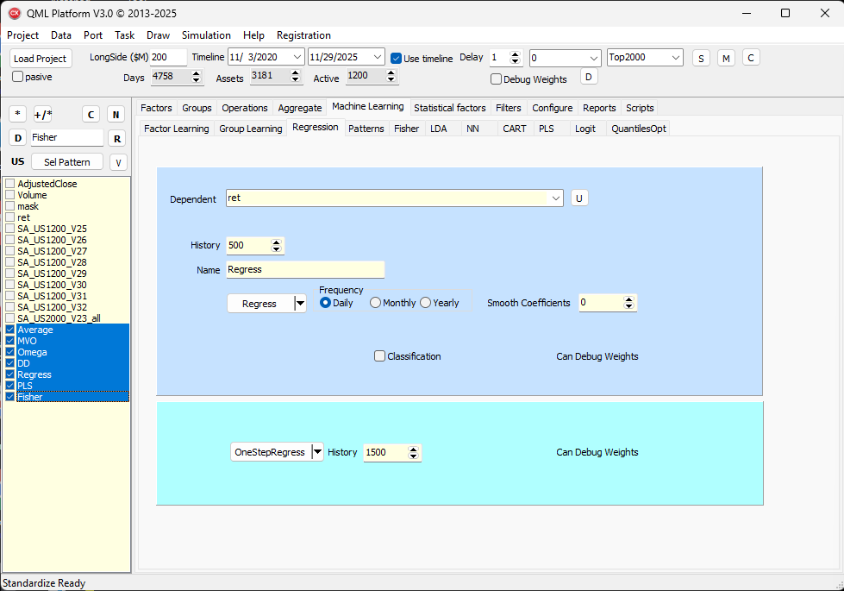
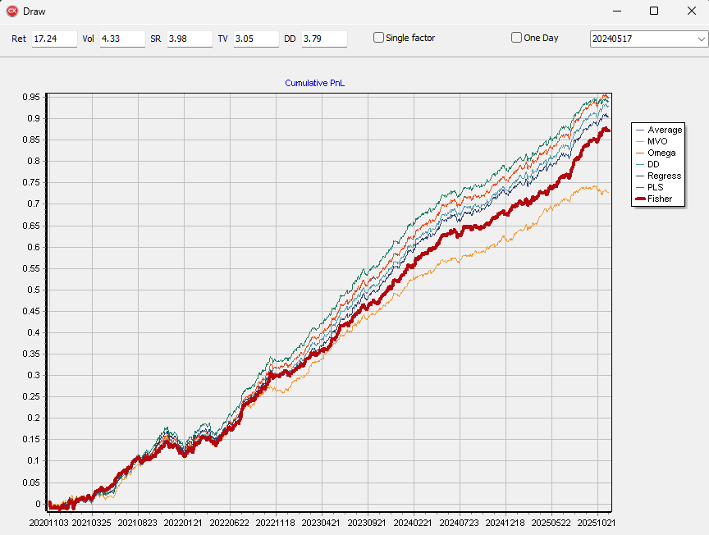
QML Alpha
Library of Model-averaging Methods
  Weighted aggregation of models based on PnL time series:
    Simple average
    Mean-variance optimization
    Weighted schemes: Omega Ratio, Drawdown, Sharpe Ratio …
Library of Machine Learning Algorithms
  Aggregation of models based on their forecasting intensity
    Factor and Group Learning
    Linear Regression
    Partial Least Square Regression
    Fisher Linear Discriminant
    …

Slide 5
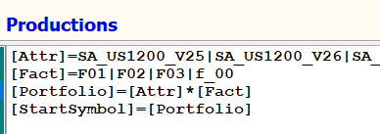
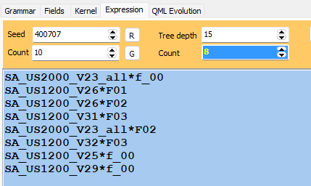
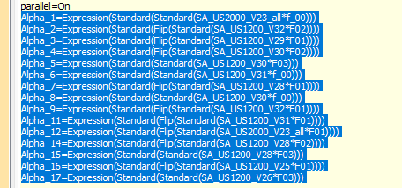
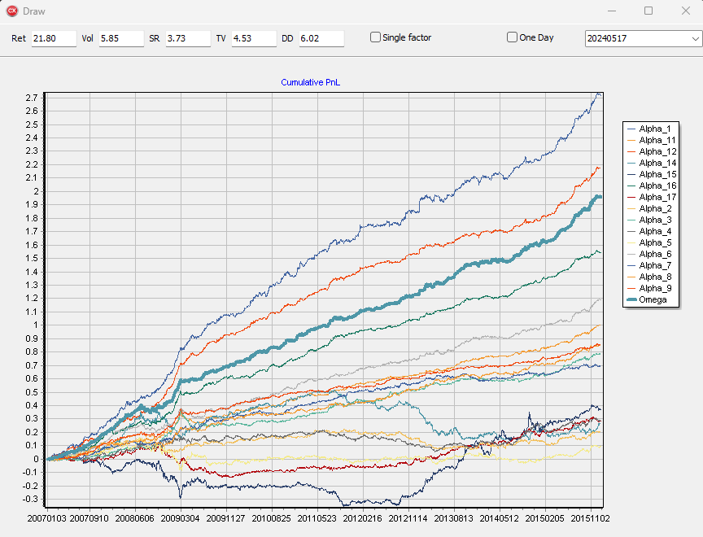
Tools for Large-scale Simulations
Generative Machine Learning framework
Thousands portfolios, sampled from the Search Space
Backtest and filter for performance
Retain qualified components
Researchers review the findings and aggregate the results into a final model
Example: Search for signals having the form:
attribute * factor_exposure
Filter: SR > 0.1
Findings:
17 Alpha components, one final aggregate

Slide 6
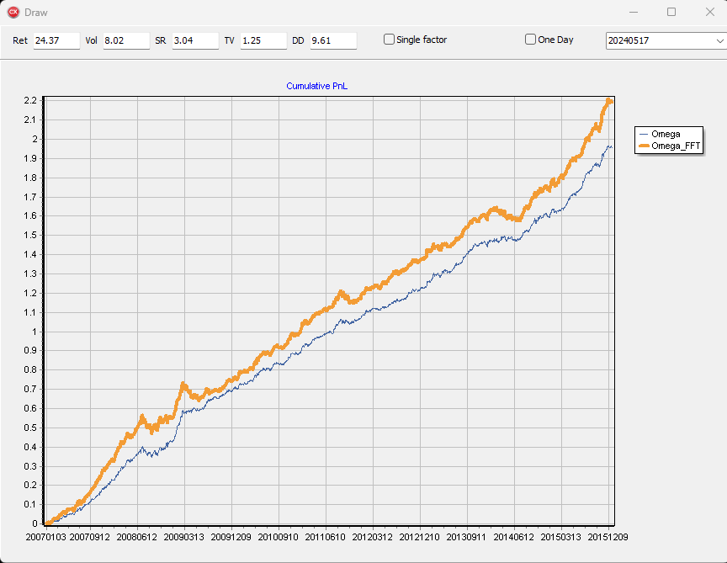
Framework for Denoising Data
Fast Fourier Transform decomposes a time series vector into frequencies; highest expressed frequencies are recombined to replace the original vector with less noise
It can be applied upstream or downstream the alpha research process
Example:
  Original signal, decomposed into frequencies of up to 1 year periods
  Recombined signal using top 50% frequencies
  SR is lower, PnL is up, and turnover is reduced

Slide 7
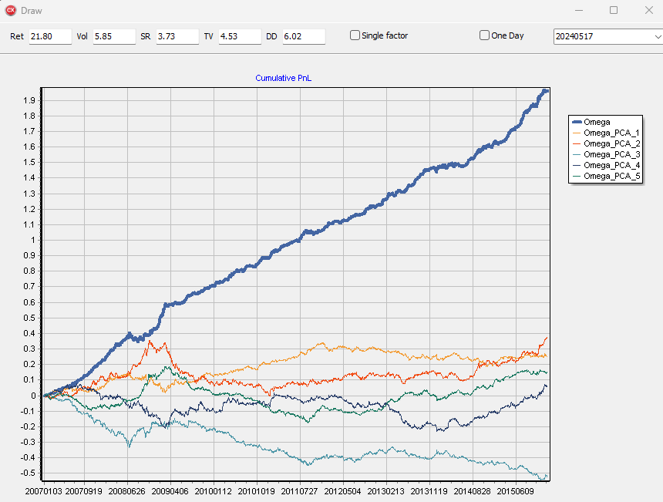
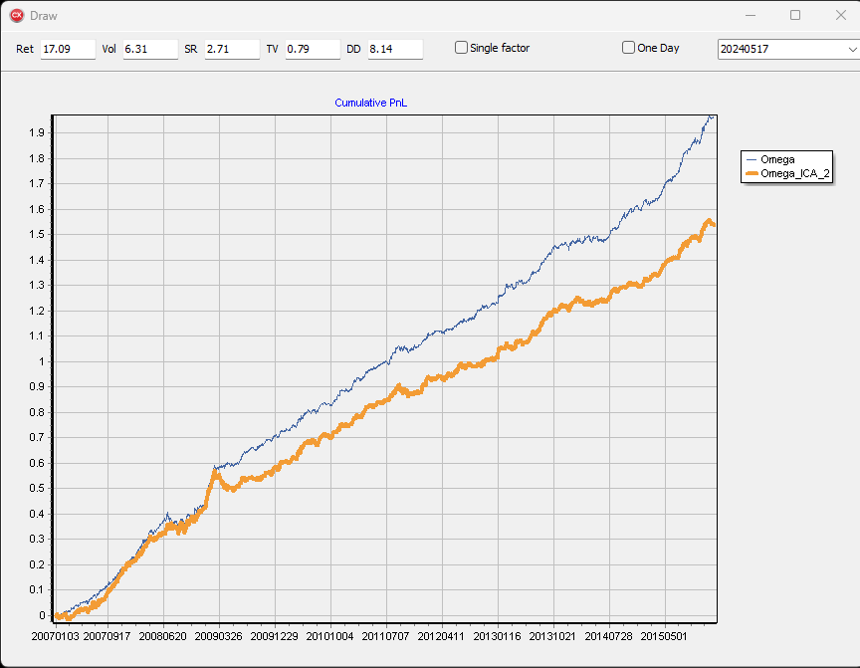
Feature Extraction
Financial data is mostly Gaussian, PCA (Principal Component Analysis) could extract meaningful information
However, if the data is not Gaussian, the ICA (Independent Component Analysis) could bring new insights

Slide 8
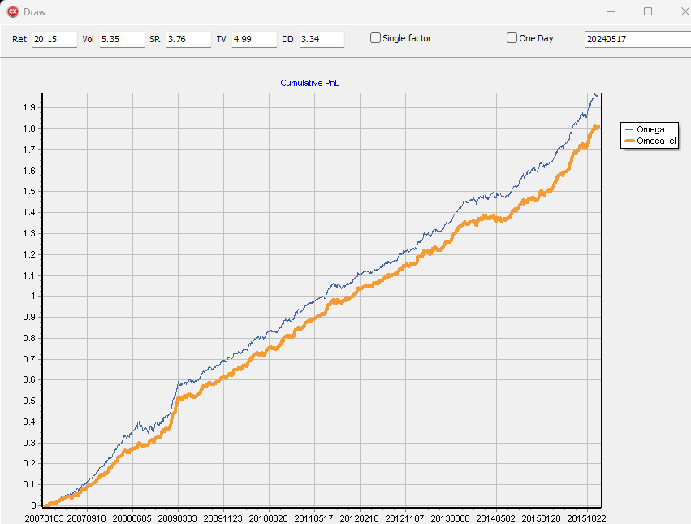
Customized Risk Models
Statistical Risk Models, 20 factors based on PCA, aligned and smoothed
Residual risk computation
Factor neutralization can half the drawdown from 6% to 3%, while preserving the Sharpe Ratio

Slide 9
Customized Groupings
Clusters and buckets on various factors can detect groupings that add hedging power, additionally to sectors and industry classification
Alpha Name | SR | AnnRet | AnnVol | Daily TV | Max DD
Omega | 3.73 | 21.80% | 5.85% | 4.53% | 6.02%
Omega_sector | 3.81 | 21.55% | 5.66% | 4.59% | 4.80%
Omega_group27 | 3.96 | 21.78% | 5.49% | 9.14% | 3.08%

Slide 10
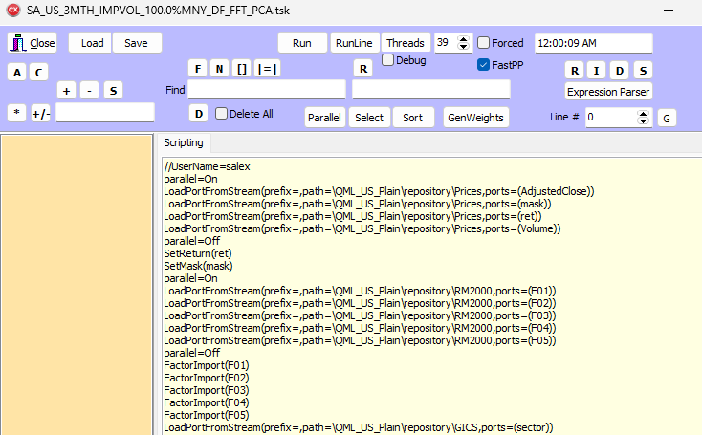
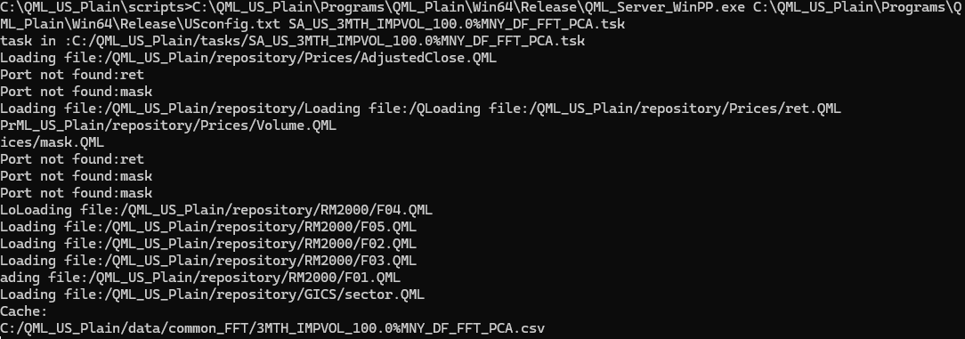
Seamless Transfer of Models from Research to Production
The QML Alpha Discovery Platform records any research activity using a proprietary scripting language
The script can be smoothly transfer to production, where the server side of the application will run in batch mode (Linux or Windows) to generate daily files
The script optimization feature will allow production to run only the necessary workload

Slide 11
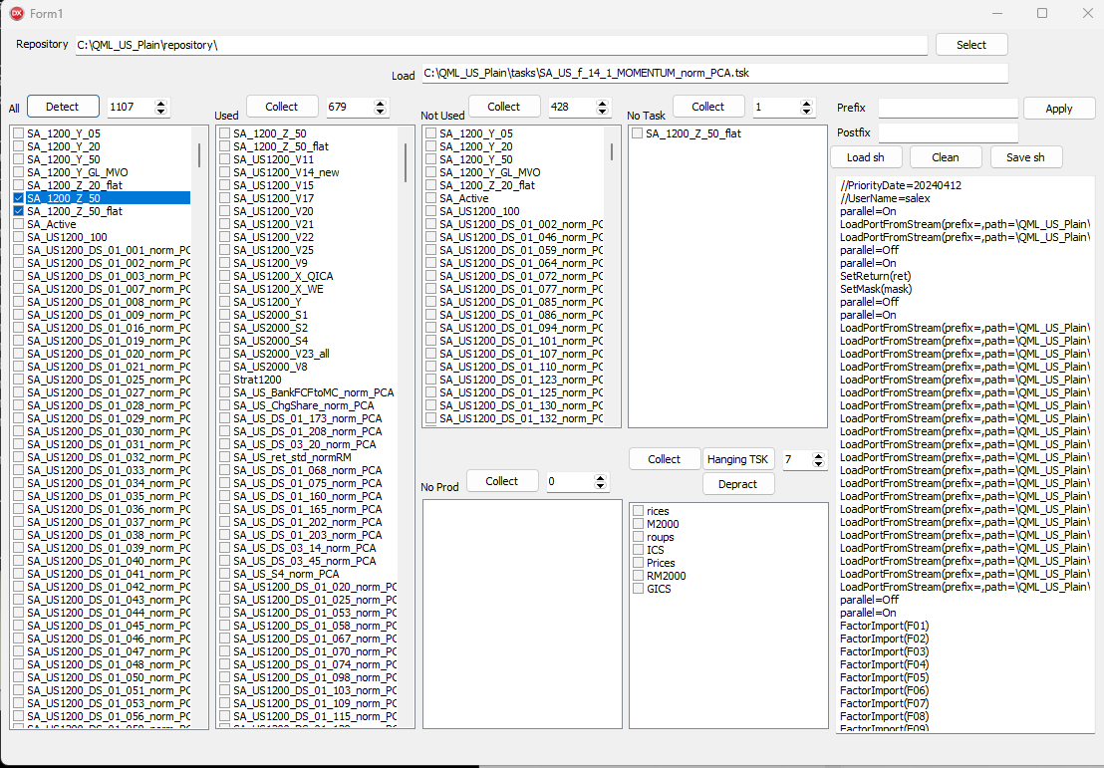
Tools for Alpha Management
While generating thousands of models, daily production requires tools for alpha management :
  What alphas are critical for the construction of current strategy?
  If production has some technical issues, can it be finalized without complete rerunning?
  What are the alphas that can be redesigned without changing the current strategy?
  What data sources were used?

